Slide 1
TASK 3: ENTERING/SOLVING A GIVEN WEBSITE USING BURPSUITE
STEPS to perform the vulnerabilily attack using Burp suite:
STEP 1:Open VIRTUAL BOX and login to KALI LINUX
STEP 2: Open Burp Suite check whether the intercept is on .
STEP 3 : Open Firefox and check the foxy proxy settings (it should be using the firefox settings ).
STEP 4 : Search for https://testasp.vulnweb.com on the browser.
STEP 5 : On the top menu click SEARCH option.
STEP 6 : Change the foxy proxy settings to burp.
STEP 7: Type any payload on the Search box . Eg. <script>alert(1)</script>
STEP 8 : Intercept the request in burp suite.
STEP 9 : Send the request to the Intruder.
STEP 10 : Load different payloads for XSS ( payloads can be download from github).
STEP 11 : START the attack .
STEP 12 : Try finding a successful payload for XSS.

Slide 2
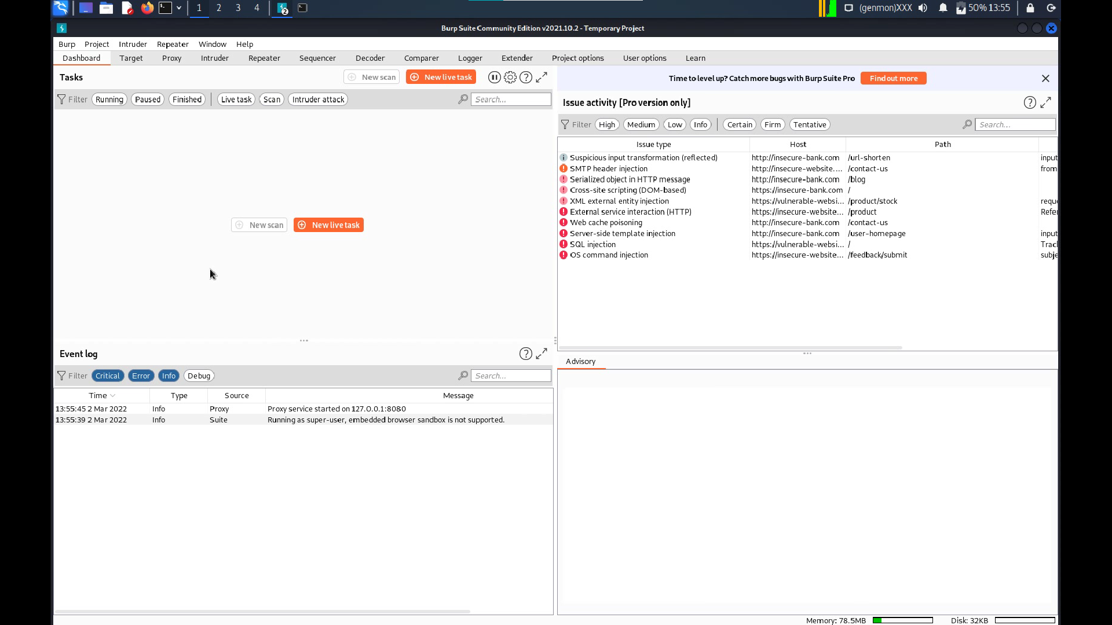

Slide 3
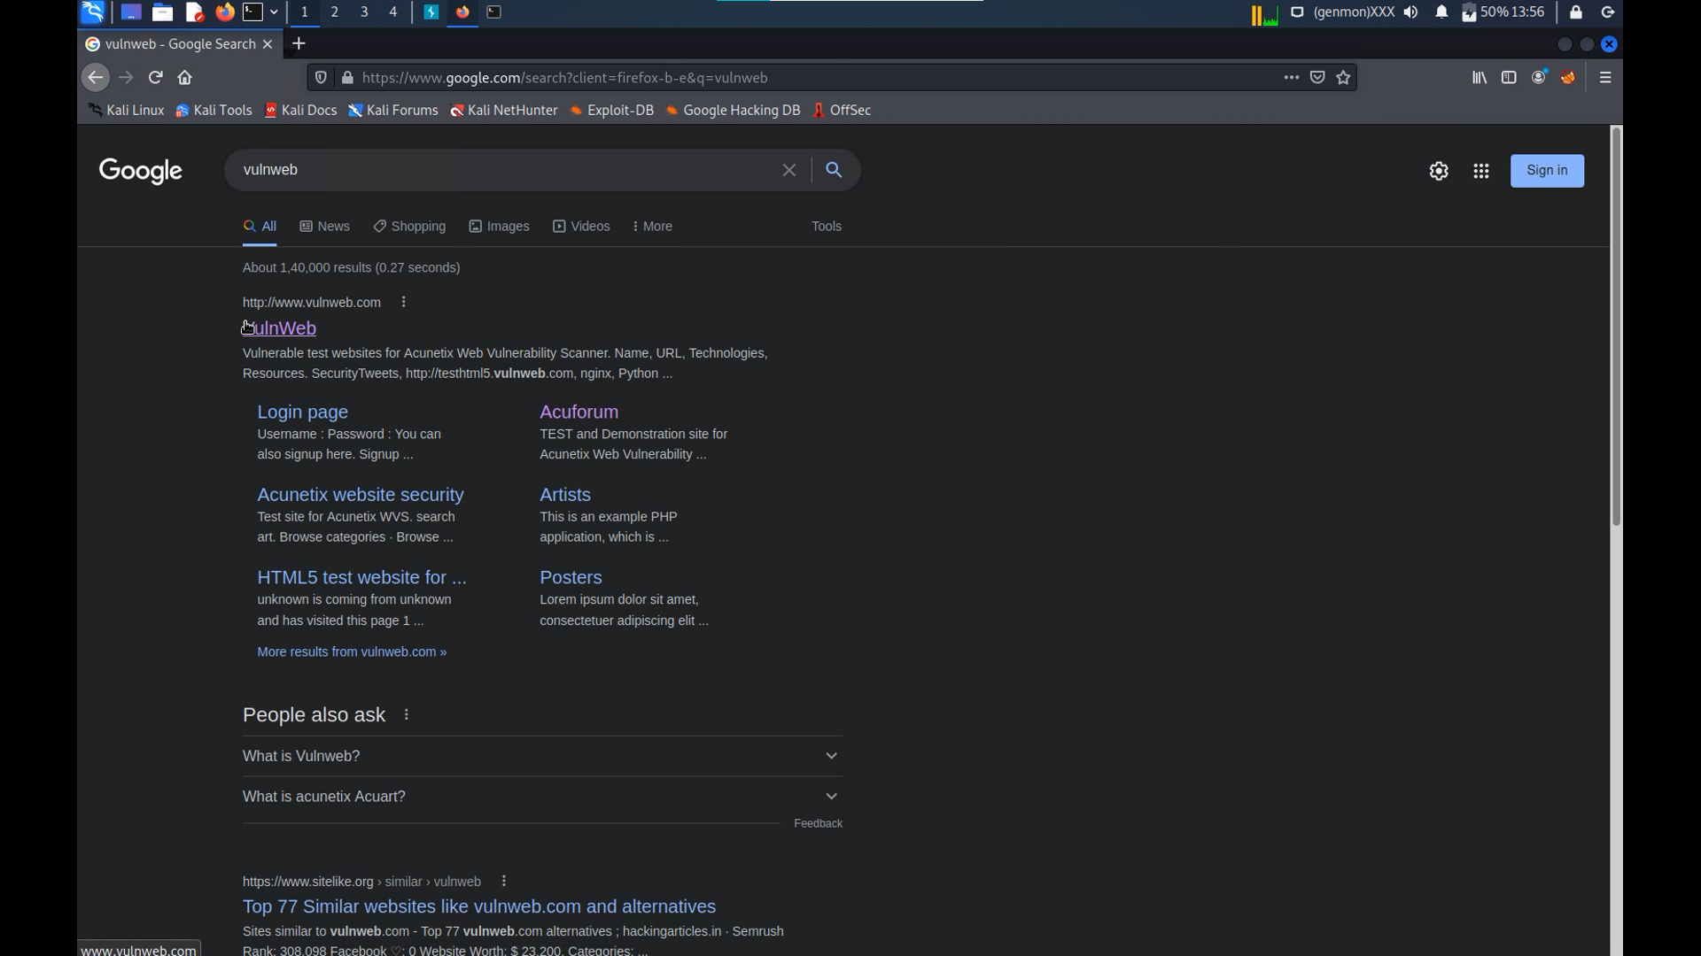

Slide 4
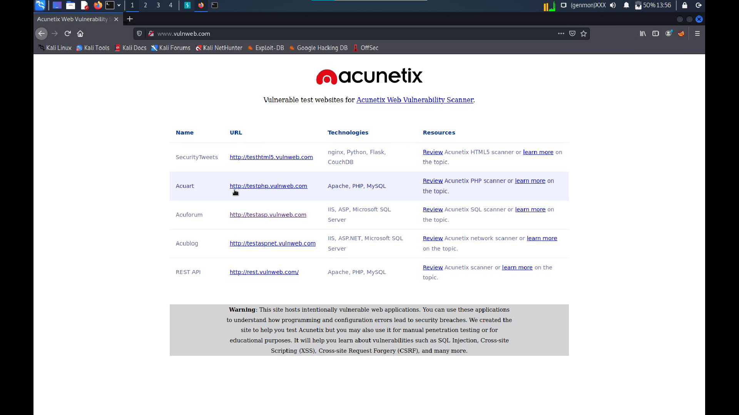

Slide 5
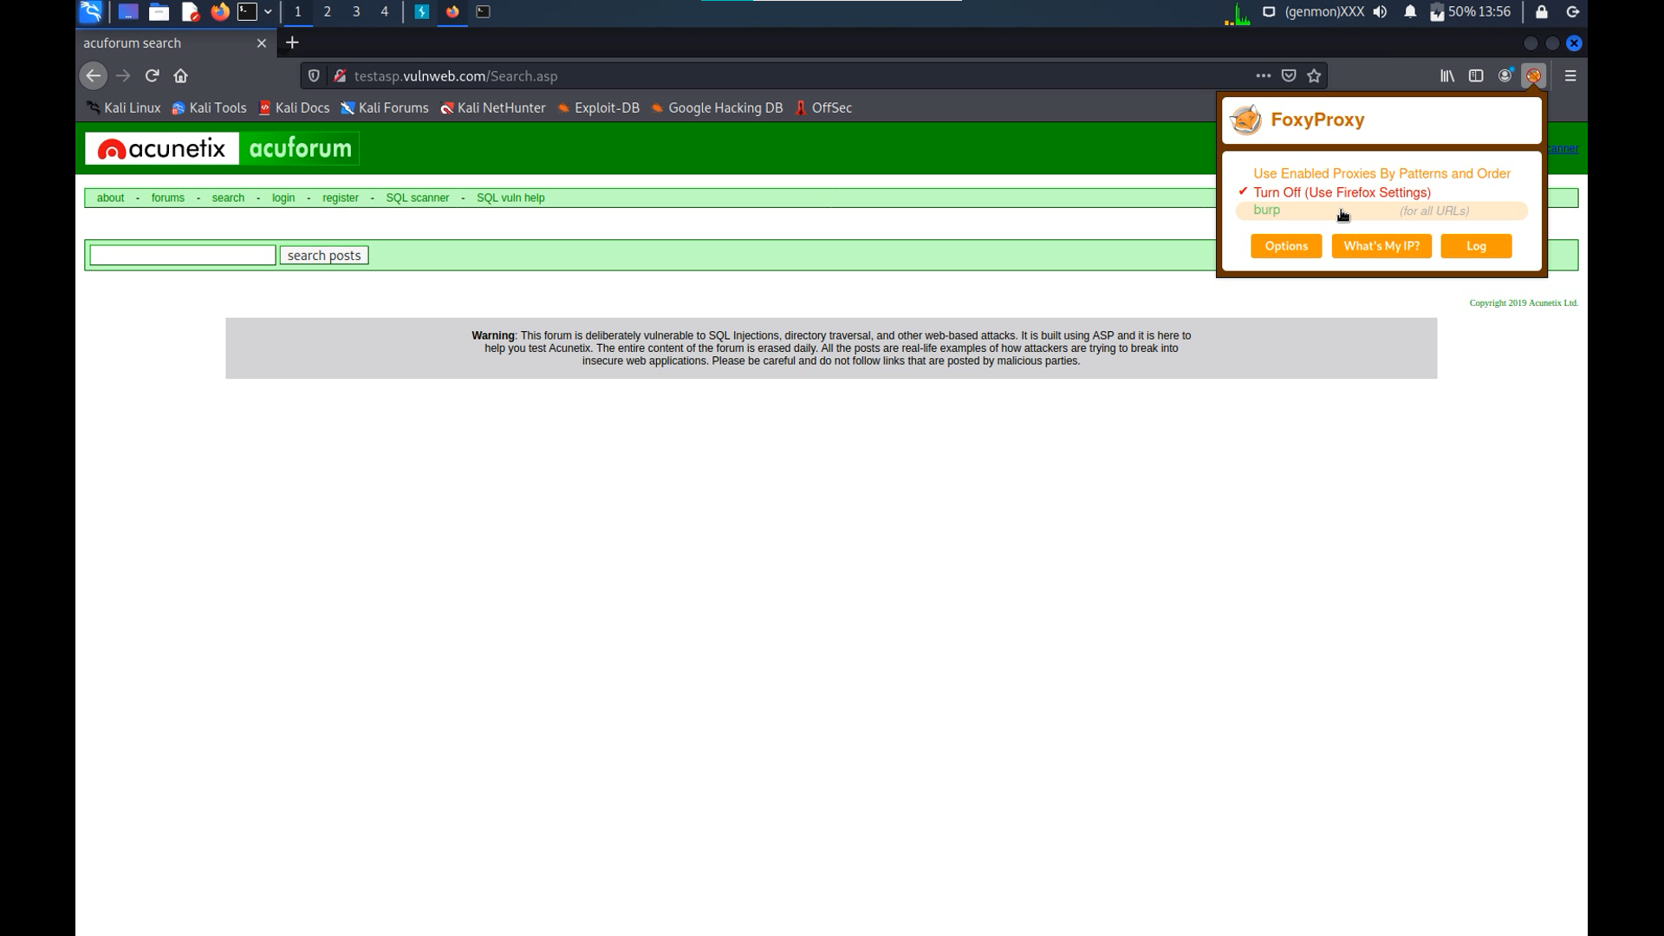

Slide 6
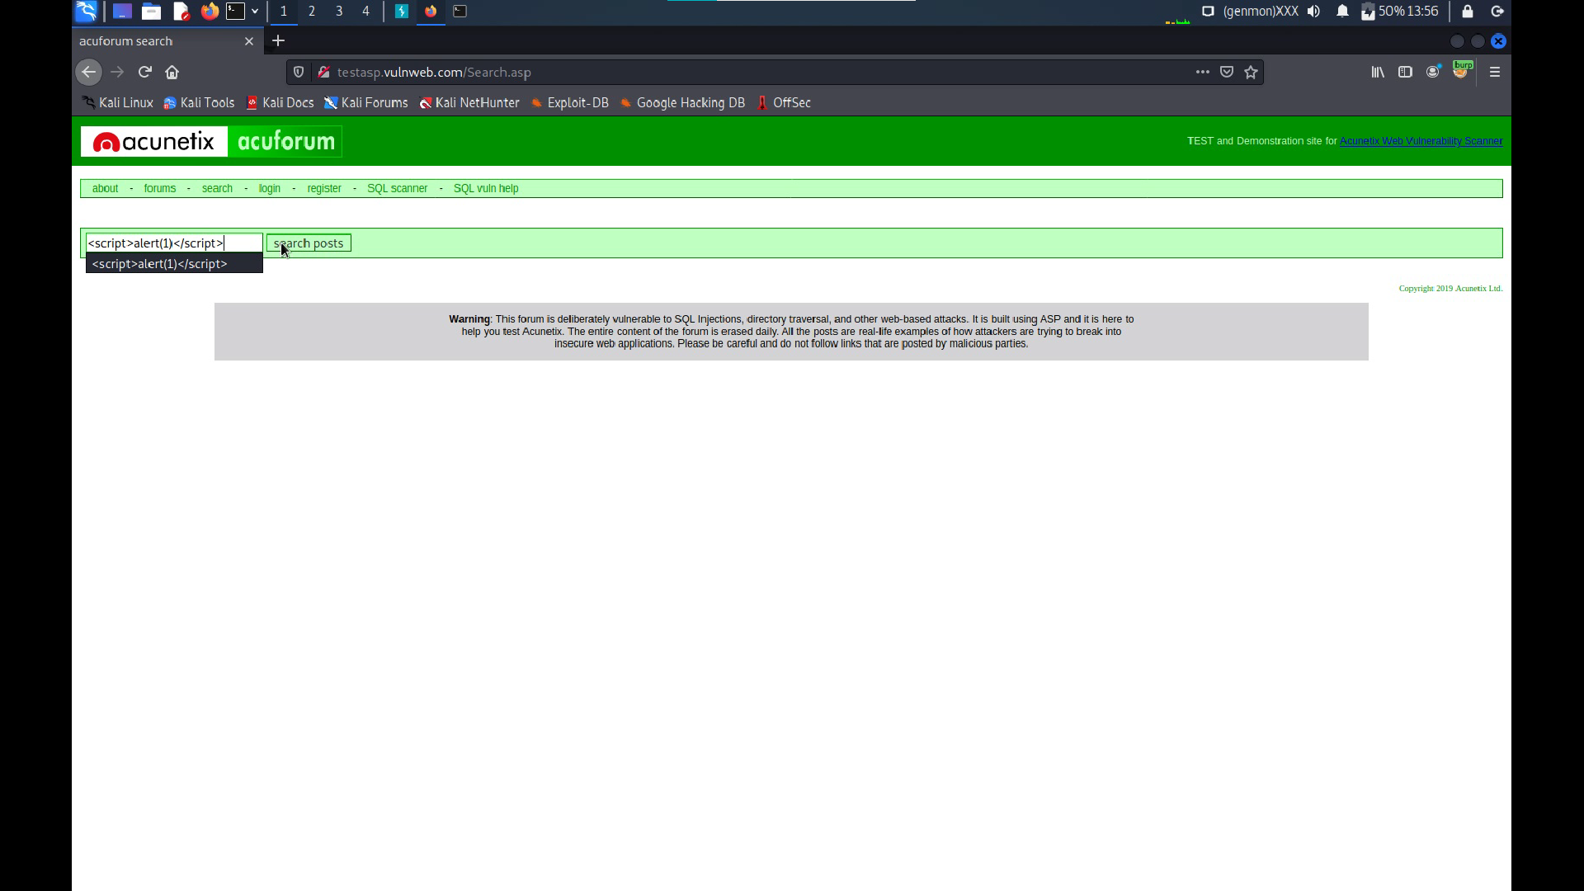

Slide 7
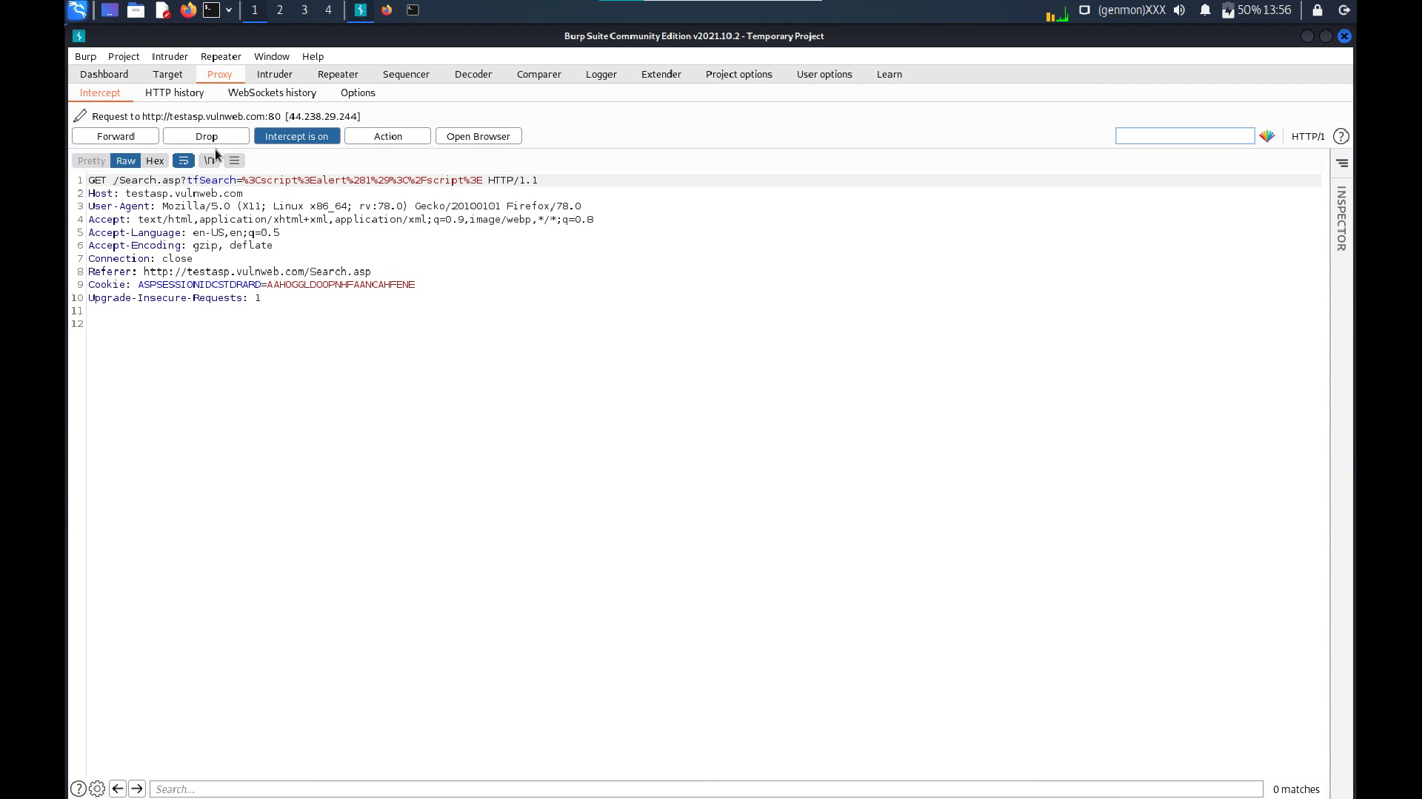

Slide 8
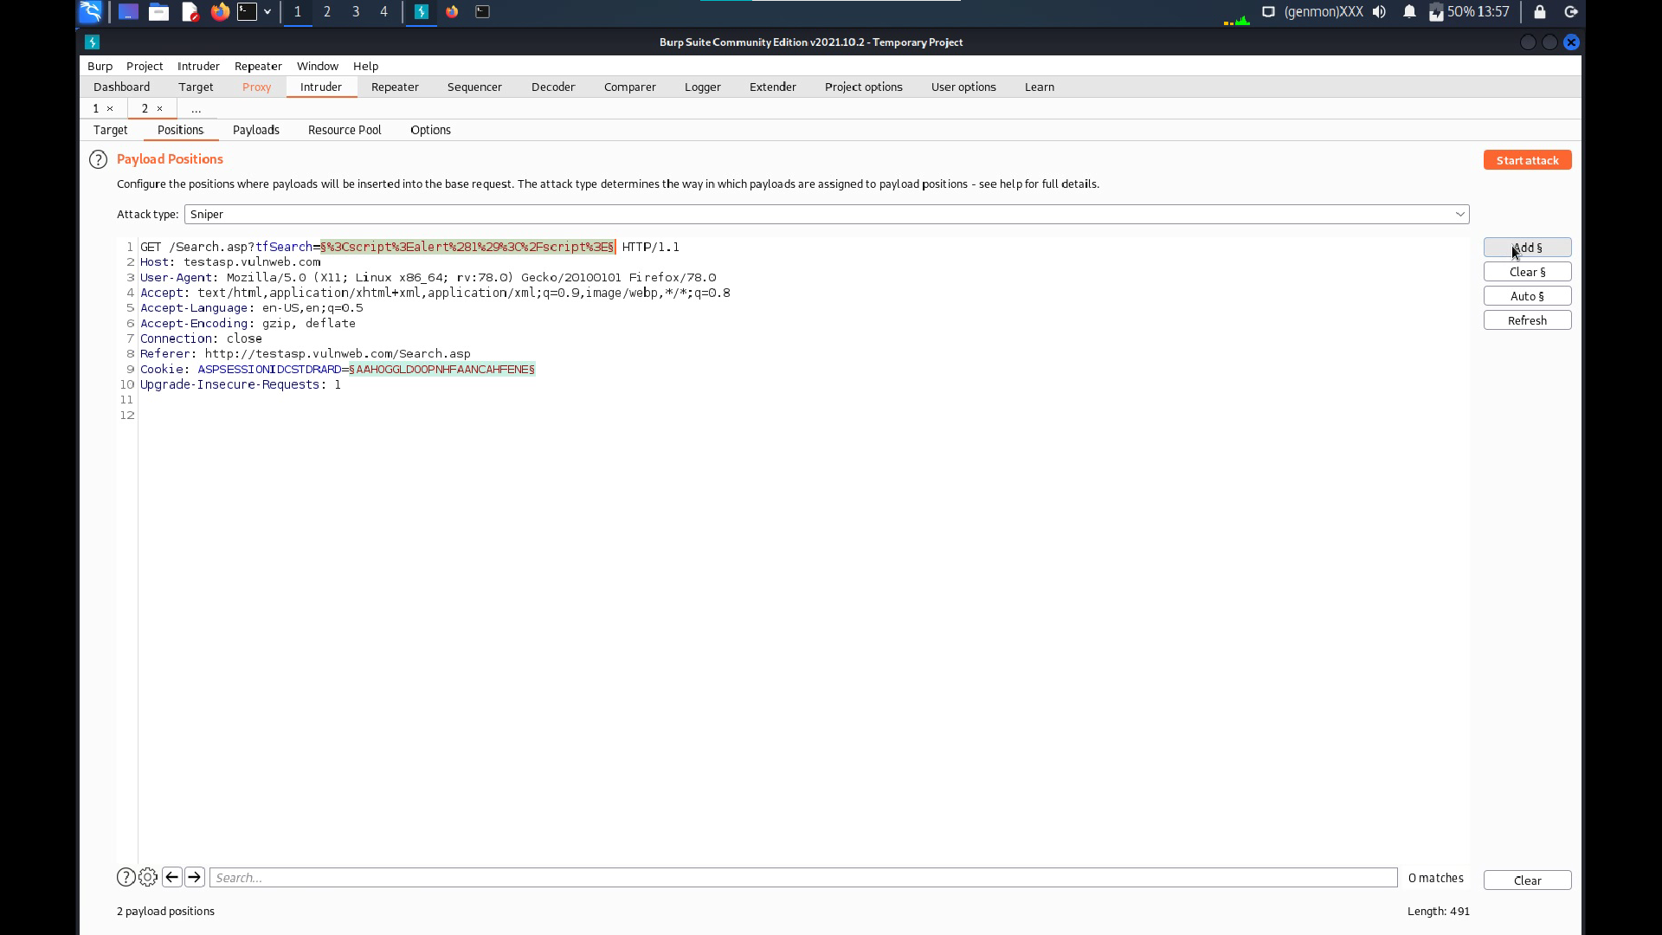

Slide 9
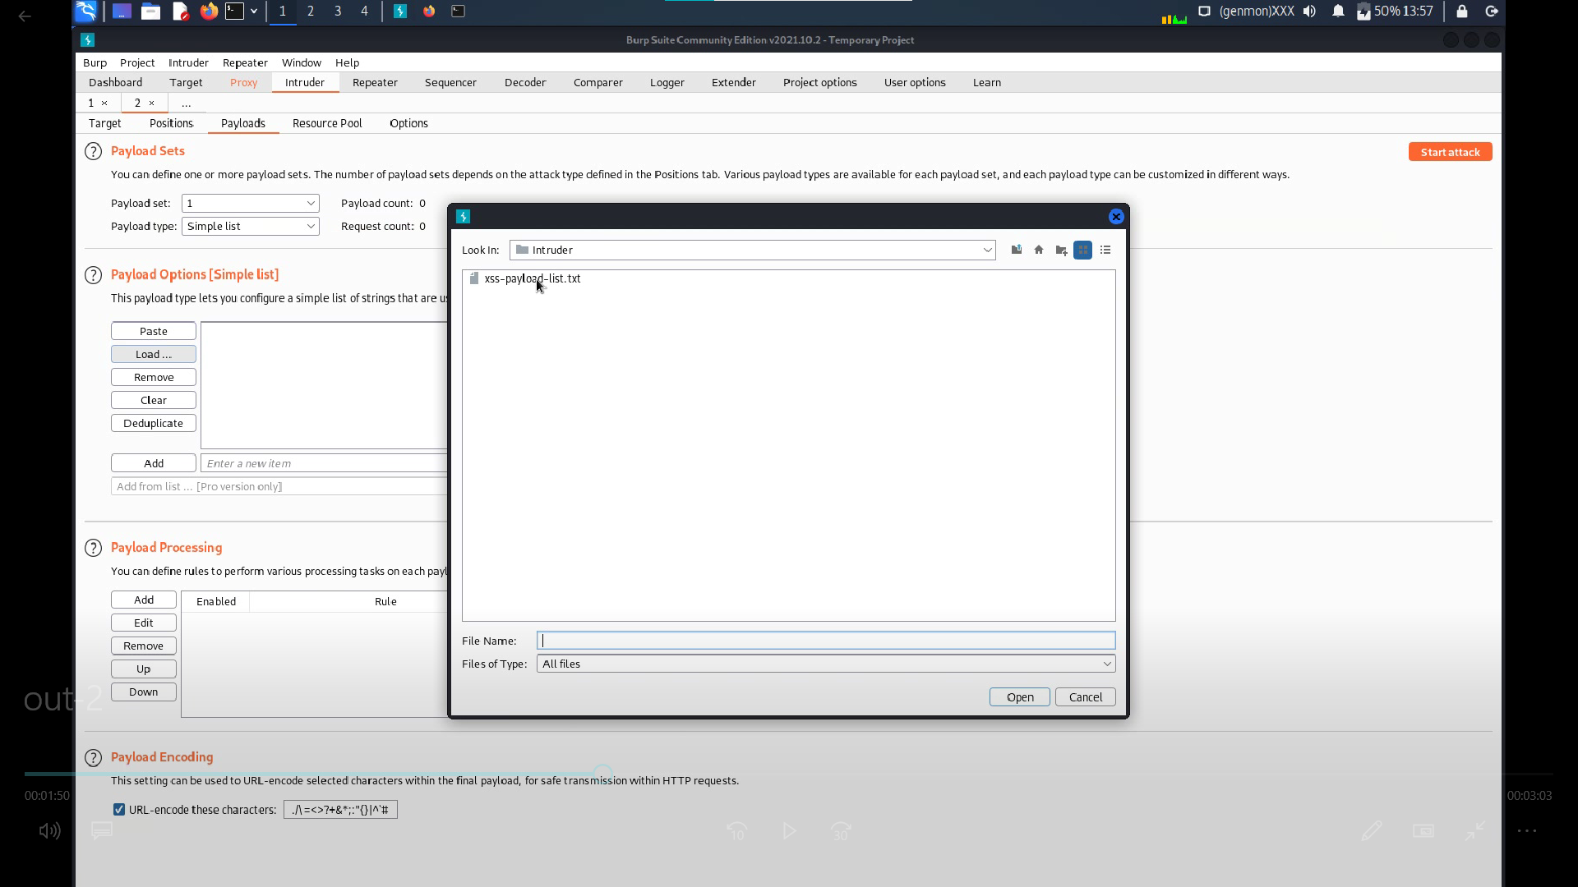

Slide 10
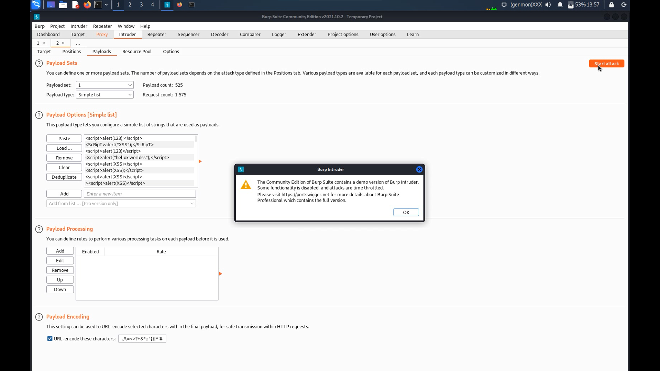

Slide 11
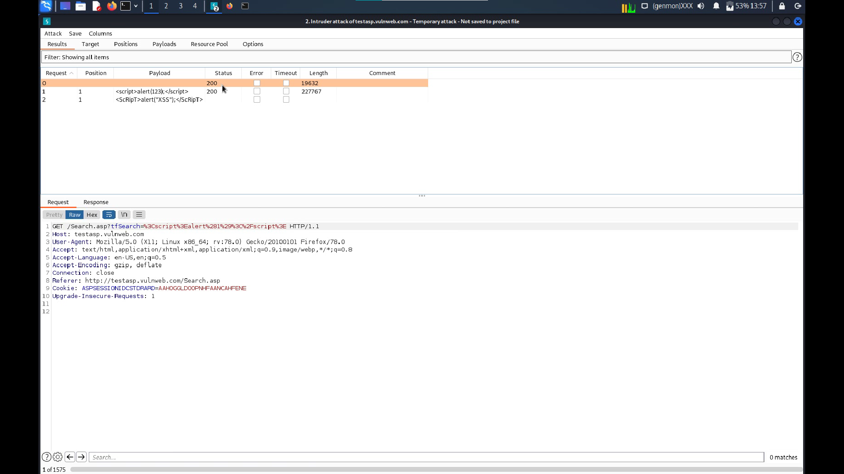

Slide 12
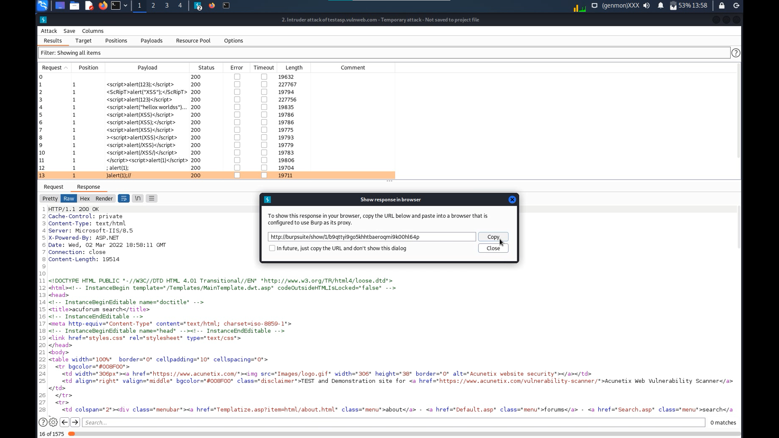

Slide 13
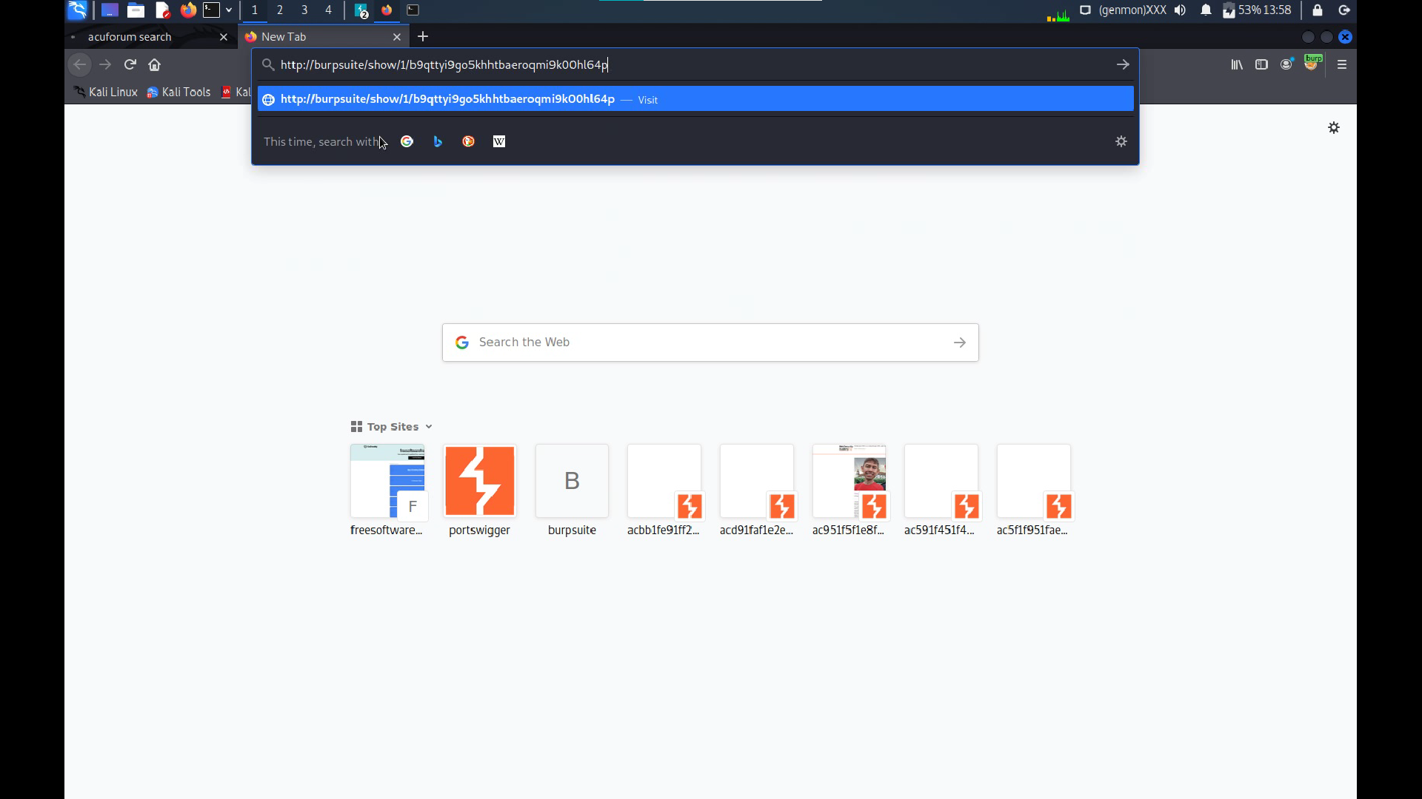

Slide 14
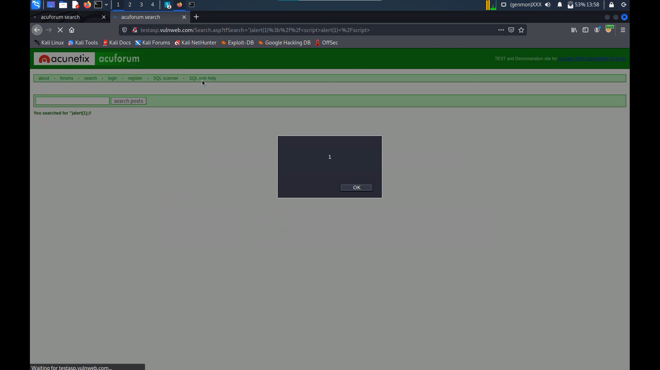

Slide 15
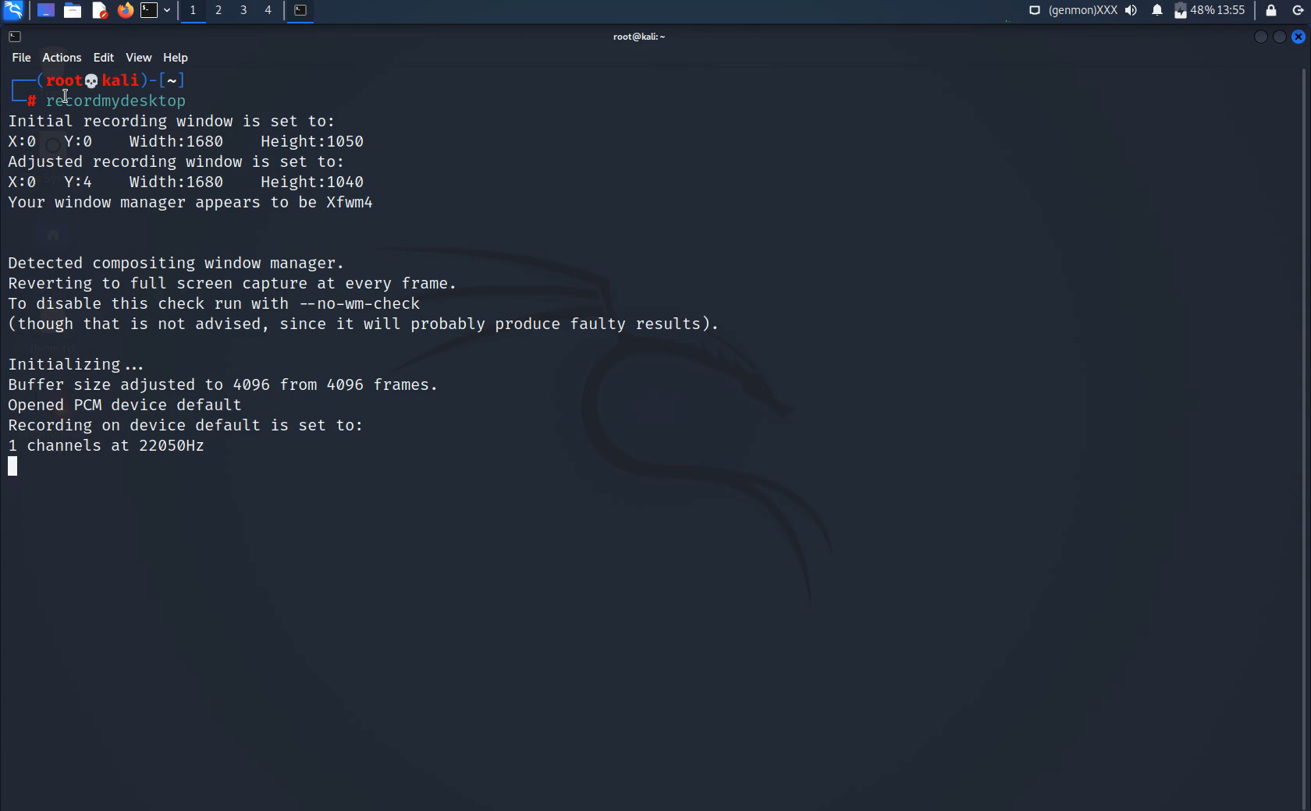

Slide 16
TITLE : CROSS SITE SCRIPTING
DOMAIN : vulnweb.com
SUBDOMAIN : testasp.vulnweb.com
SUMMURY :
The website https://testasp.Vulnweb.Com has an injection vulnerability – namely a REFLECTED CROSS SITE SCRIPTING (XSS) . Cross site scripting (XSS) is a cyberattack method that involves running malicious code as part of a vulnerable web application. It primarily targets the user. XSS have been a part of the OWASP TOP 10 most critical web application ranking since its creation and were even at the top of the list in 2007. Cross site scripting vulnerabilities aim at injecting malicious content or functionality in websites, which affect the visitors or users of the website rather than the application itself directly. While the threat is known, the problem remains.

Slide 17
STEPS TO REPRODUCE : STEP 1 : Search for https://testasp.vulnweb.com on the browser. STEP 2 : On the top menu click SEARCH option. STEP 3 : Change the foxy proxy settings to burp. STEP 4 : Intercept the request in burp suite. STEP 5 : Send the request to the Intruder. STEP 6 : Load different payloads for XSS ( payloads can be download from github). STEP 7 : START the attack . STEP 8 : Try finding successful payload for XSS. STEP 9 : Copy the response and open in browser response URL https://burpsuite/show/1/b9qttyi9go5khhtbaeroqmi9k00hl64p STEP 10 : You will see 1 as a response on the screen.

Slide 18
Impact
Cross site scripting attacks can have devastating consequences. Code injected into a vulnerable application can exfiltrate data or install malware on the user’s machine. Attackers or black hat hackers can masquerade as authorized users via session cookies, allowing them to perform any action allowed by the user account.
A hacker can deface a corporate website by altering its content, thereby damaging the company’s image or spreading misinformation . this scenario is particularly dangerous if the target is a government website or provides vital resources in times of crisis.
Perform any action within the application that the user can perform.
View any information that the user is able to view.
Modify any information that the user is able to modify.
Initiate interactions with other application users, including malicious attacks, that will appear to originate from the initial victim user.
Xss prevention: reflected xss
1. Sanitizing inputs
2. Use HTTP only cookie flag
3. Implement content security policy

